Slide 1
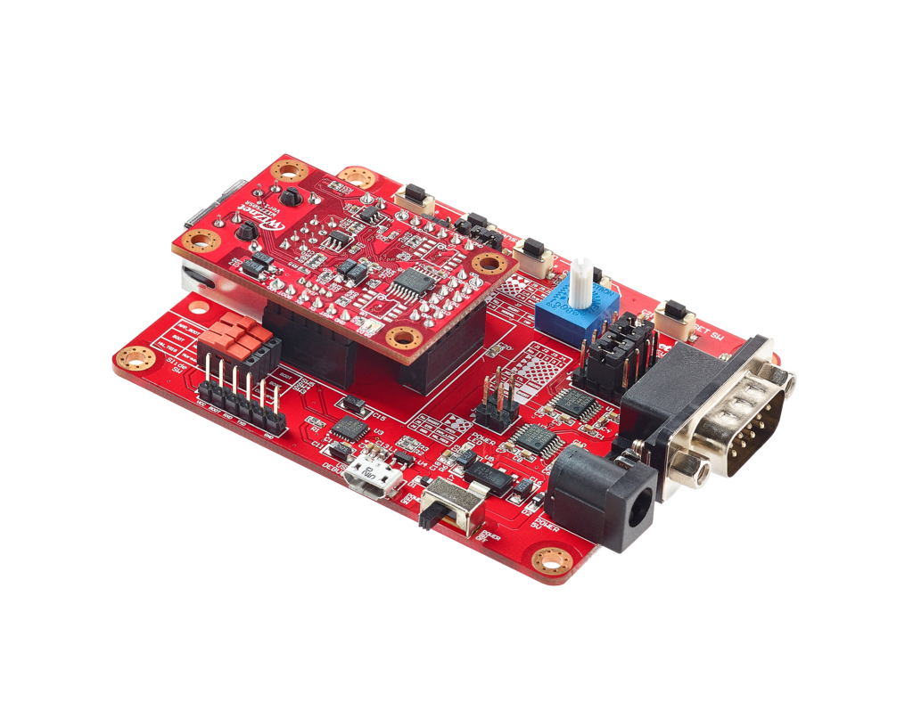
WIZ750SR Programming
Prepared By:
Biswajit Padhi

Slide 2
What is WIZ750SR ? ? ?
WIZ70SR is the compact sized serial to Ethernet module using W75050P, WIZnet iMCU, cortex-M0. WIZ750SR is the protocol converter that transmits the data sent by serial equipment as TCP/IP data type, and converts back the TCP/IP data received through the network into serial data to transmit back to a serial equipment.

Slide 3
Basic Features:
Serial to Ethernet Module based on W7500P
RJ-45 mounted, Pin-header type module
TTL, RS-232 Serial signals: TXD, RXD, RTS, CTS, GND (optional DSR,DTR) (TTL, RS-232 transceiver optionally built-in)
RS-422/485 Serial signals: TXD+, TXD-, RXD+, RXD- (RS-422/485 transceiver optionally built-in)
Support the configuration method of AT command & Configuration tool program
Support password function for the security
10/100Mbps Ethernet & Max.230kbps serial speed
Support WIZ VSP (Virtual Serial Port) program

Slide 4
PROGRAMMING ENVIRONMENT

Slide 5
STEPS TO USE ARMMBED COMPILER
These steps are quite same as the programming steps for Wizwiki w7500
Only after downloading the .bin file we need a separate tool to flash the program.

Slide 6
STEPS TO USE WIZ750SR ISP

Slide 7
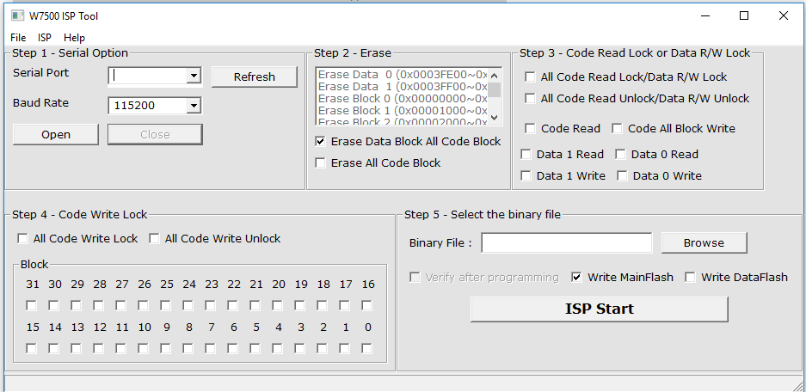
OPEN WIZ7500P ISP tool

Slide 8
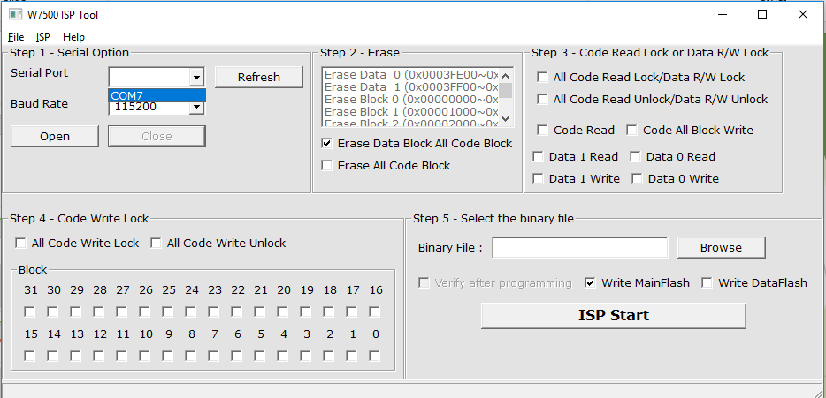
Click on the “Refresh” button to get the COM Port

Slide 9
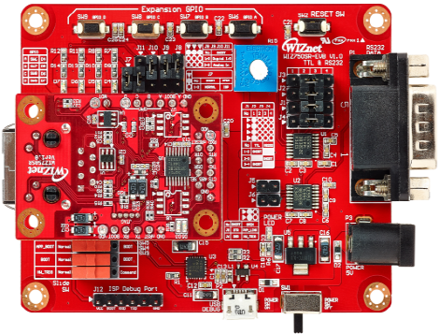
Switch on the BOOT switch and press “Reset” to enter boot mode

Slide 10
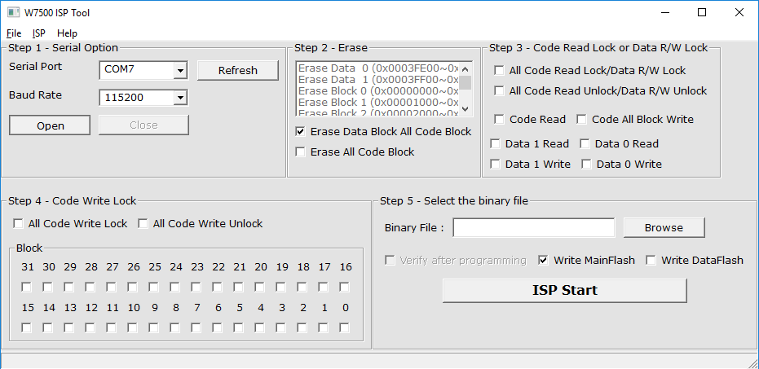
After selecting the COM port, click on “Open to open the Serial terminal

Slide 11
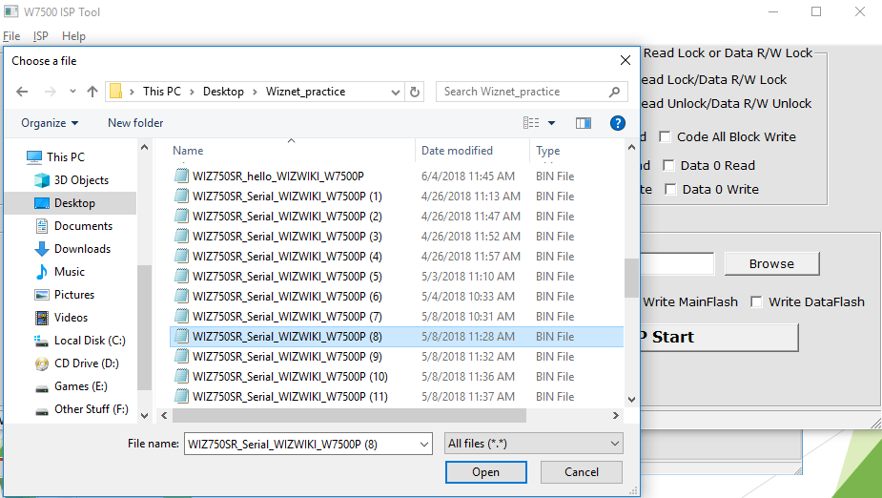
Click on “Browse” in Step 5 window and select your .bin file and click “Open”

Slide 12
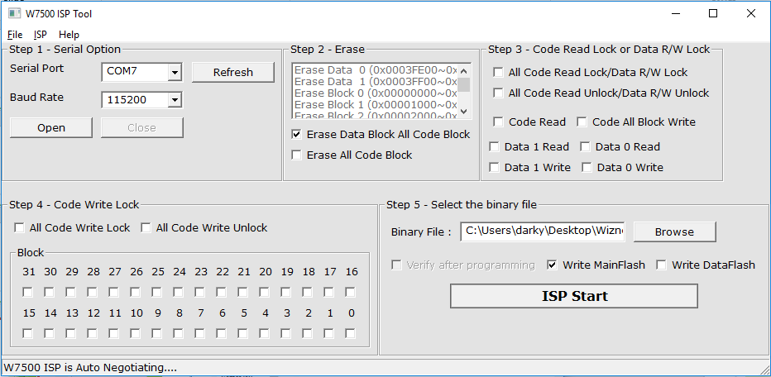
Click on “ISP Start” to flash the .bin file to the WIZ750SR board

Slide 13
Switch off the boot switch and press “Reset” to check the output

Slide 14



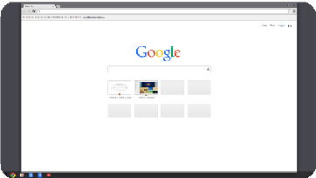




HTTP Request
Web Browser
WIZ750SR
HTTP Response
BASIC SERVER CLIENT MODEL

Slide 15
HTTP Method
GET
Method to get value of Web Server
Client obtain DATA in Web Server storage
POST
• Method to transmit changed value to Web Server
• When value is changed from Client, Device(Server) receive this request and then change value.

Slide 16
WIZ750SR Server Programming

Slide 17
Source code link: https://os.mbed.com/users/wiznetw7500/code/WIZ750SR_test/

Slide 18
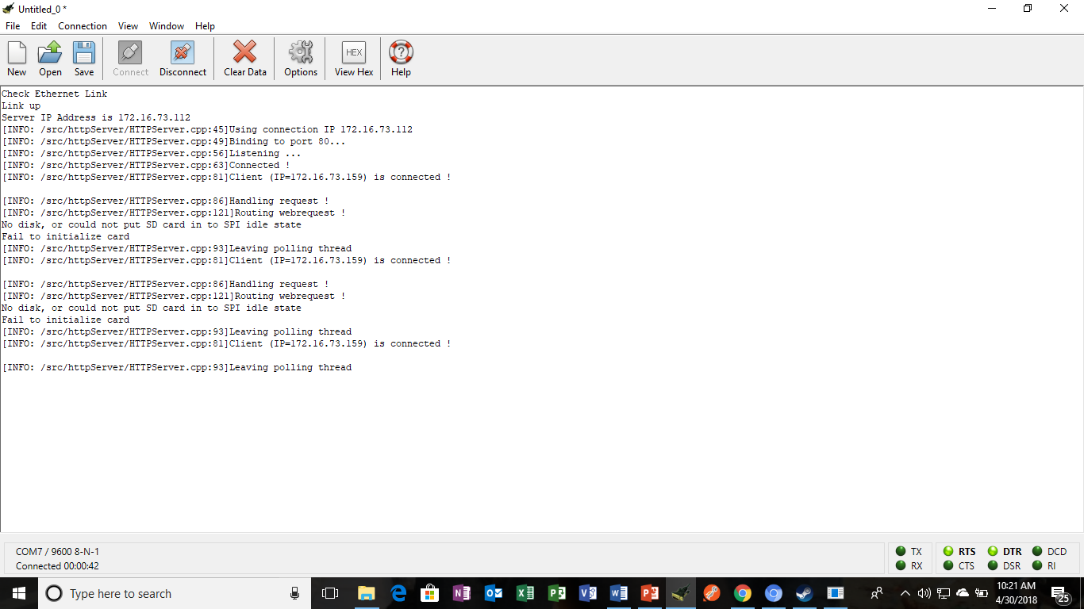

Slide 19
What is DHCP ? ? ?
Only if computer should have unique IP address is to access internet. But if DHCP is used, internet access is possible without unique IP address.
DHCP lease valid IP which can use for a period of time to Client that request IP. Therefore, if there is more computers than the number of available IP addresses, DHCP can dynamically reconfigure network by making short the lease time of IP address.

Slide 20
WIZ750SR Client Programming (Weather Forecasting)

Slide 21
For Weather forecasting: api.openweathermap.org Source code link: https://os.mbed.com/users/wiznetw7500/code/WIZ750SR_test_client_Weather_forecast/

Slide 22
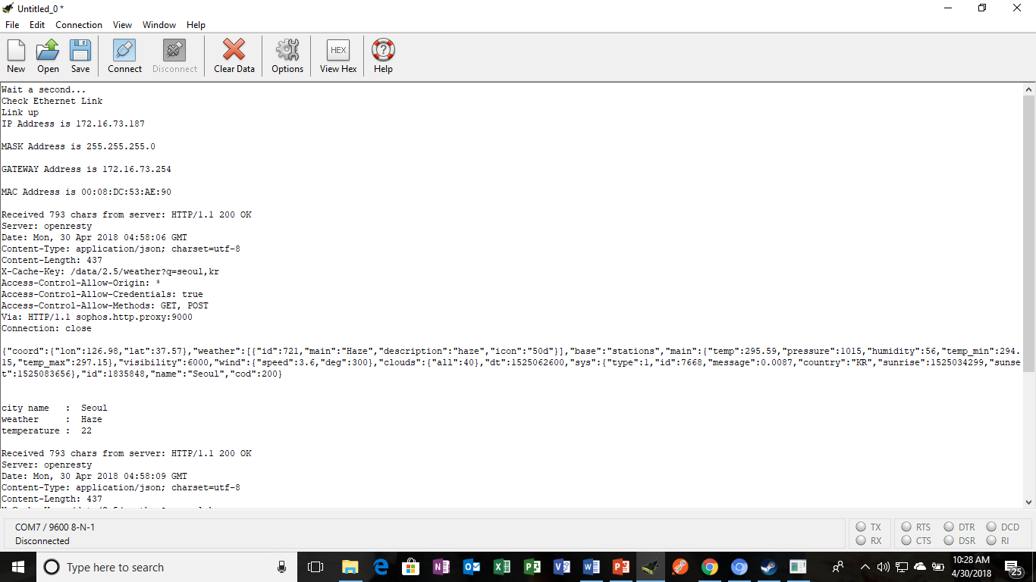

Slide 23
WIZ750SR Client Programming (ThingSpeak Cloud)

Slide 24
For ThingSpeak: www.thingspeak.com Source code link: https://os.mbed.com/users/wiznetw7500/code/WIZ750SR_test_client_ThingSpeak/

Slide 25
